Slide 1

Genetic Algorithms
What are genetic algorithms?
Genetic algorithm components
Example problem
Common questions about genetic algorithms
Example applications
Important references for genetic algorithms
Ten summary points
Demonstrations with Evolver

Slide 2
How large is the decision space?
If we were to look at every alternative, what would we have to do? Of course, it depends.....
Think: enzymes
  Catalyze all reactions in the cell
  Biological enzymes are composed of amino acids
  There are 20 naturally-occurring amino acids
  Easily, enzymes are 1000 amino acids long
  20^1000 = (2^1000)(10^1000) ≈ 10^1300
A reference number, a benchmark:
10^80 ≈ number of atomic particles in universe

Slide 3
How large is the decision space?
Problem: Design an icon in black & white
How many options?
  Icon is 32 x 32 = 1024 pixels
  Each pixel can be on or off, so 2^1024 options
  2^1024 ≈ (2^20)^50 ≈ (10^6)^50 = 10^300
Police faces
  10 types of eyes
  10 types of noses
  10 types of eyebrows
  10 types of head
  10 types of head shape
  10 types of mouth
  10 types of ears
  but already we have 10^7 faces

Slide 4
How large is the decision space?
Arranging n things
Putting 100 things in the right order
  100!
How many ways?
  n! = n(n-1)(n-2).....1
  ? (fact 3)
  6
  ? (fact 5)
  120
  ? (fact 100)
  93326215443944152681699238856266700490715968
  26438162146859296389521759999322991560894146
  397615651828625369792082722375825118521091686
  4000000000000000000000000

Slide 5
Heuristic Search
Decision spaces are typically extremely large
Some algorithms are available for effectively searching certain “nice” decision spaces (e.g., linear programming)
But most problems are “not so nice” and we lack programmed solution techniques
Yet humans routinely solve such problems
Amazing! What’s going on?

Slide 6
Heuristic Search
Build rule-based expert systems
  Performance so far not super impressive (somewhat impressive)
  Doesn’t show what’s needed. Only shows that there exist such rules, not how they are found or how cognition could work. (rule-governed vs rule-described)
  Expensive and very time-consuming in general
Build programs that acquire rules automatically
  Genetic algorithms
  Performance so far is very impressive (e.g., suspect ID)
  Still time-consuming, but can hope for a general architecture

Slide 7
What are genetic algorithms?
Genetics and evolution
  survival of the fittest gene pool - natural selection
  meiosis involves exchange of genetic material - crossover
  maintain genetic diversity - mutation
Adaptive systems
  finite automata / machine learning / history of GAs
Efficient search algorithm for complex problems
  randomly generate a population of potential solutions
  calculate fitness of each potential solution
  allow best individuals to breed - selection and crossover (p<.6)
  allow low probability mutations (p<.007) to maintain diversity
  check for convergence of populations in the gene pool

Slide 8
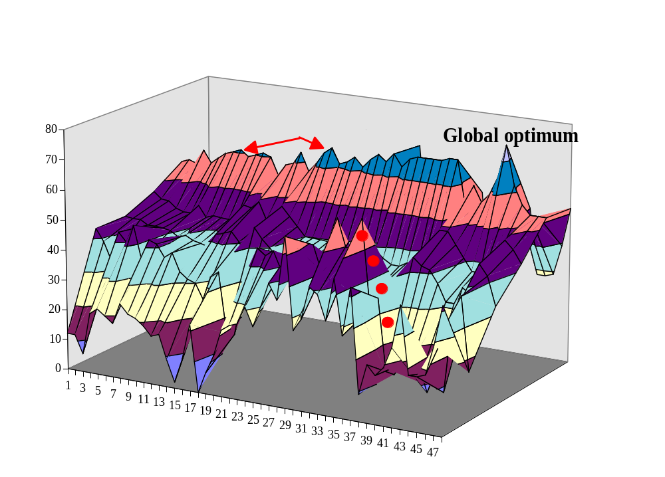
Genetic algorithms vs hill climbing

Slide 9
Genetic Algorithm Components
Selection
  determines how many and which individuals breed
  premature convergence sacrifices solution quality for speed
Crossover
  select a random crossover point
  successfully exchange substructures
  00000 x 11111 at point 2 yields 00111 and 11000
Mutation
  random changes in the genetic material (bit pattern)
  for problems with billions of local optima, mutations help find the global optimum solution
Evaluator function
  rank fitness of each individual in the population
  simple function (maximum) or complex function

Slide 10
Genetic Algorithms:
Example Problem
Annual sales for Avoiding Extinction by JWI Publishers is 20,000 copies. Books are sold for $30.
JWI Publishers have a variable cost of $6 per book associated with producing the book.
JWI Publishers have two fixed cost components. Overhead, royalties and other costs total $350,000. Setup cost per printing is $6,000. Thus, 4 quarterly printing would cost 4 x $6,000 = $24,000.

Slide 11
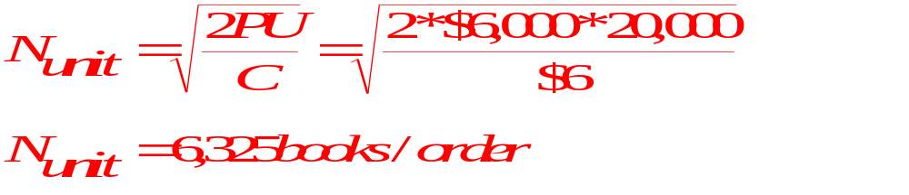
Genetic Algorithms:
Example Problem
Annual sales for Avoiding Extinction by JWI Publishers is 20,000 copies. Books are sold for $30.
JWI Publishers have a variable cost of $6 per book associated with producing the book.
JWI Publishers have two fixed cost components. Overhead, royalties and other costs total $350,000. Setup cost per printing is $6,000. Thus, 4 quarterly printing would cost 4 x $6,000 = $24,000.
EOQ model yields

Slide 12
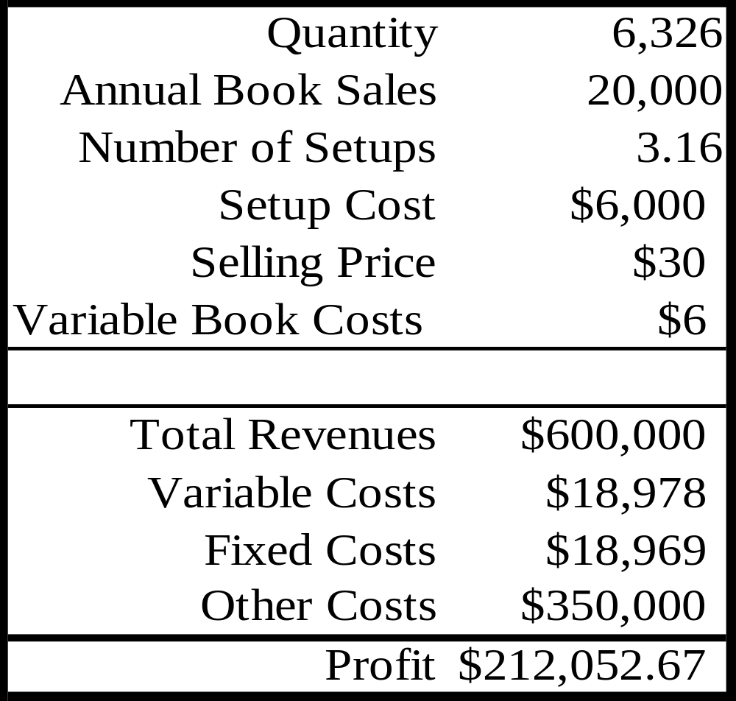
Genetic Algorithms:
Example Problem

Slide 13
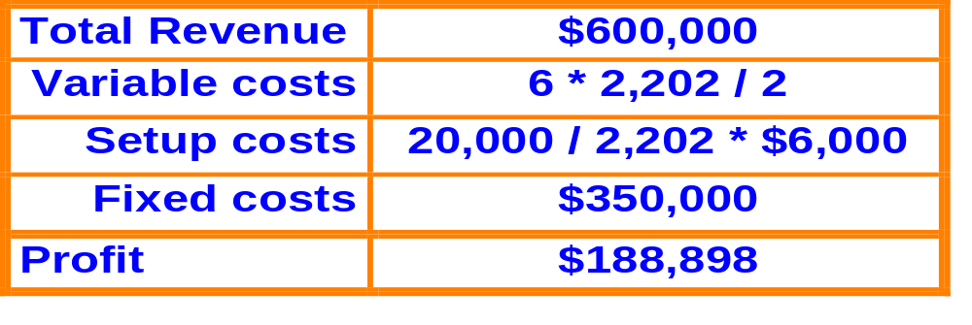
Genetic Algorithms:
Example Problem
Choose the problem representation
  14 digits binary string allows an order size from 1 to 16,384 (2¹⁴)
Initialize the population
  randomly generate 100 - 200 individual strings of length 14
Calculate fitness for each individual
  convert string to decimal and determine profit with that order size
  00100010011010 = 2,202

Slide 14
Genetic Algorithms:
Example Problem
Perform selection
  long run survival of the fittest
  short run merely nudges population towards better performers
  replace the worst strings ( bottom 5%) with copies of the best strings ( top 5% ), thus it would take a minimum of 20 generations before all strings are replaced - slow convergence.
Perform crossover
  randomly select two parents from the new population
  randomly determine whether to crossover ( p = .6 )
  if crossover, randomly select a crossover point (1-13)
  example:
  00100010011010 (2,202) x 11011001000111 (13,895)
  at 3 yields
  11000010011010 (3,655) x 00111001000111 (12,442)

Slide 15
Genetic Algorithms:
Example Problem
Perform mutation
  bit by bit, string by string, randomly determine whether to mutate each bit using a very low probability (p=.007). If mutation rate is too high, it will prevent convergence.
  if mutation should occur, change 0 to 1 or vice versa.
Check convergence
  bias is one measure of agreement among the population
  bias assumes values between 50 and 100 percent
  bit bias
    if 100 strings have 0 in position 1 and 100 have a 1, then the bit bias is 50%
    a 75:25 split or a 25:75 split has a 75% bias
    a 90:10 split or a 10:90 split has a 90% bias
  string bias is the average bias for each bit over all strings
  a population with a average bias of 95% has converged

Slide 16
Common Questions about
Genetic Algorithms
Can a GA converge to a poor solution?
  YES! Poor problem representation, premature convergence, a poor fitness evaluation algorithm, or luck of the random numbers could generate a poor solution
How do you know whether the GA solution is optimal or near optimal?
  If you knew how to find the optimal solution, you would not need to use a GA. There is no guarantee that a GA will find an optimal solution. GAs find a good solution that is “better” than others.
Are neural networks better than GAs?
  Neural networks require less structural knowledge. However, the type and number of node connections and hidden layers make it difficult to interpret relationships in a neural network.
  GAs require a starting framework to setup the problem representation and calculate fitness

Slide 17
Genetic Algorithms:
Example Applications
Criminal suspect recognition using Faceprints
  Developed by psychology department of New Mexico State University
  Uses GAs to aid witnesses in the identification of criminal suspects
  Easy to identify criminal from photo but hard to describe features
  Difficult to generate even from computer library of visual features
  GA approach:
    randomly generate 20 faces on a computer screen
    witness rates each face on a 10 point scale
    GA generates additional faces from 5 building blocks:
    eyes, mouth, nose, hair and chin. Each is a 7 bit string.
    The five features are coded as a 35-bit binary string consisting of five 7-bit parameters (34 billion faces are possible)
    Witness evaluates successive generations with 10 point scale
    Convergence often occurs after 20 generations

Slide 18
Genetic Algorithms:
Example Applications
Currency trading
  Prediction Company, Santa Fe New Mexico, developed GAs for currency trading
  left-hand sides of the rule predict when time-series data enter specific regions
  right-hand sides of the rule predict whether the time-series will go up or down
  objective function measures mean-squared error
Complex data base queries
  Boolean operators, multiple algebraic and logical relationships create large complex search spaces
  Bennett K., Ferris M.C., & Ioannidis Y.E., (1989) developed a novel encoding of chromosomes to represent a binary tree query graph.
  System was able to find solutions when traditional search methods yielded too many non-relevant articles

Slide 19
Genetic Algorithms:
Example Applications
Inter-office fiber-optic networks
  US West designs expansion plans for large networks
    old method began with designer intuition and experience
    multiple rings of interconnected fiber-optic cable with a maximum of 48 nodes per ring
    tested design with a network simulation tool
  GA approach used a mutation operator to determine whether to expand the existing ring or add a new ring
    first, fitness uses computer simulation to test performance
    second, fitness uses cost to rank best performers
  Saves $1-$10 million per design
    design time cut from 2 person-months to 2 person-days
    total 6 years savings could exceed $100 million

Slide 20
Genetic Algorithms: Summary
Field is not new. Holland’s work began in 1970s.
Most of the work has been done in computer science & engineering - not business applications
Translate problem into a string representation - often binary numbers (11000)
Difficult to perform translation for some problems
Little knowledge at startup - randomly generated population of individuals

Slide 21
Genetic Algorithms: Summary
Must be able to calculate fitness of each individual in the population
Potential solutions with greater fitness have greater priority in subsequent generations
Crossover is similar to mating and mutation transforms a stable population to maintain diversity of the search process
Steps 6-8 repeat. Eventually the population converges and the fittest solution survives
GAs are not an optimization technique but often find good solutions for large complex problems

Slide 22
Important References for
Genetic Algorithms
Holland, J.H. 1975. Adaptation in natural and artificial systems. Ann Arbor, MI: The University of Michigan Press.
  classic technical book with lots of theorems and proofs
Goldberg, D.E. 1989. Genetic algorithms in search, optimization, and machine learning. Reading, MA: Addison-Wesley.
  graduate textbook for a machine learning course - code in Pascal
Davis, L. (ed) 1991. Handbook of genetic algorithms. New York: Van Nostrand Reinhold.
  tutorial and case applications with code in C or Lisp

Slide 23
Important References for
Genetic Algorithms
Koza, J. 1992. Genetic programming: On the programming of computers by means of natural selection. Cambridge, MA: MIT Press.
  application of programs as bits rather than 1s and 0s
Bauer, R.J. Jr. 1994. Genetic algorithms and investment strategies. New York: Wiley.
  examples of GAs used for trading bonds and stocks
Karjalainen, R. and Allen F. 1994. Using genetic algorithms to find technical trading rules. Wharton working paper

